Slide 1


Chapter 21. Signals : Signal Handler
Linux
January 22, 2018
Jeyeon Lee
Dept. of Software
Dankook University
2reenact@naver.com

Slide 2
Chapter Objectives
How to design a signal handler
Methods of terminating a signal handler
Handling of signal on an alternate Stack
The usage of sigaction() SA_SIGINFO flag
How a system call may be interrupted by a signal handler
How the system call can be restarted

Slide 3
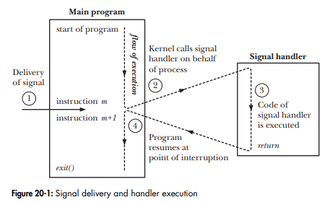

Designing Signal Handlers (1/4)
Signal handlers
write simple to reduce the risk of creating race condition

Slide 4
Designing Signal Handlers (2/4)
Two common designs for signal handlers
the signal handler sets a global flag and exit
the main program periodically checks this flag
if the flag is set, takes appropriate action
the signal handler performs some type of cleanup
then terminates the process or uses a nonlocal goto to unwind the stack
Signals are not queued
the delivery of a signal is blocked during the execution of handler
if the signal is generated more than once, it will later be delivered

Slide 5
Designing Signal Handlers (3/4)
Reentrant and Async-signal-safe function
single-threaded & multi-threaded programs
single-threaded program
classical UNIX program
CPU processes instructions for a single logical flow of execution
multi-threaded program
there are multiple, independent, concurrent logical flows of execution
reentrant & nonreentrant functions
reentrant function
can safely be simultaneously executed by multiple threads of execution
achieves its expected result, regardless of the state of execution of others
nonreentrant function
If it updates global or static data structures

Slide 6

Designing Signal Handlers (4/4)
Standard async-signal-safe functions
what is async-signal-safe function?
implementation guarantees to be safe when called from a signal handler
a function is safe when it is reentrant or not interruptible by a handler
two choices for writing signal handlers
make the signal handler reentrant & to call only async-signal-safe-function
block signals while calling unsafe functions or working with global data
global variables can be safe with sig_atomic_t which is a global flag

Slide 7
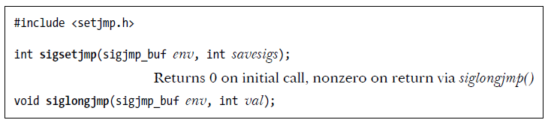
Terminating a Signal Handler (1/2)
Ways of terminating a signal handler
use _exit() to terminate the process
unsafe because of flushing action
use kill() or raise() to send a signal to kill the process
perform a nonlocal goto from the signal handler
longjmp() doesn’t restore the signal mask and signals are not unblocked
use sigsetjmp() or siglongjmp()

Slide 8
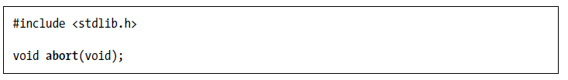
Terminating a Signal Handler (2/2)
Ways of terminating a signal handler
use the abort() function to terminate the process with a core dump
this will terminate the calling process and produce its core dump
abort() override the effect of blocking or ignoring SIGABRT in SUSv3

Slide 9
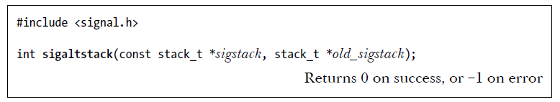
Alternate Stack (1/2)
to create a frame for any handler
Allocate an area of memory called an alternate signal stack
Inform the kernel of the existence of the alternate signal stack
use the signalstack() system call
Signal handler is specified by the SA_ONSTACK flag

Slide 10
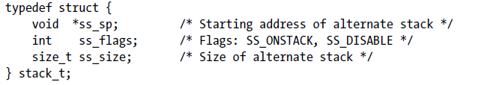
Alternate Stack (2/2)
The stack_t structure
ss_flags
SS_ONSTACK : the process is executing on the alternate signal stack
SS_DISABLE : there is no currently established alternate signal stack

Slide 11
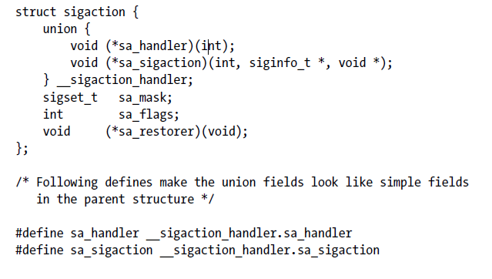
SA_SIGINFO flag (1/2)
Declaring & Usage of handler

Slide 12
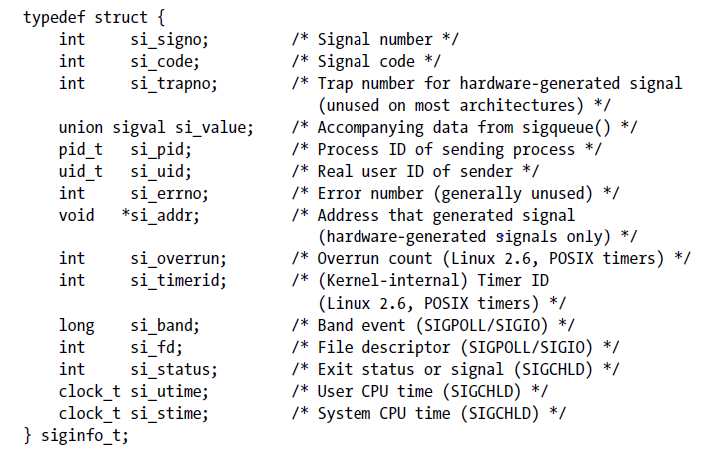
SA_SIGINFO flag (2/2)
The siginfo_t structure

Slide 13
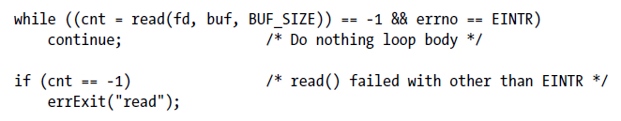
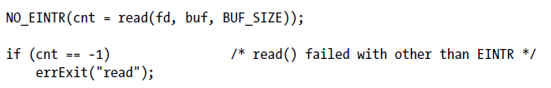
Interruption & Restarting of System Calls (1/2)
Restarting an interrupted system call manually

Slide 14
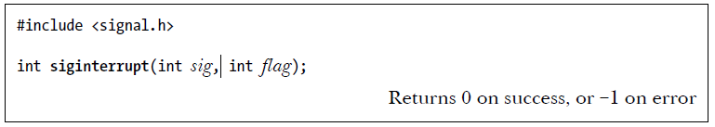
Interruption & Restarting of System Calls (2/2)
Modifying the SA_RESTART flag
use siginterrupt() function to change the SA_RESTART setting
If flag is true, a handler for sig will interrupt blocking system calls
If flag is flase, the blocking system calls will restarted after handler

